Slide 1
Databricks Health care POC Demo

Slide 2
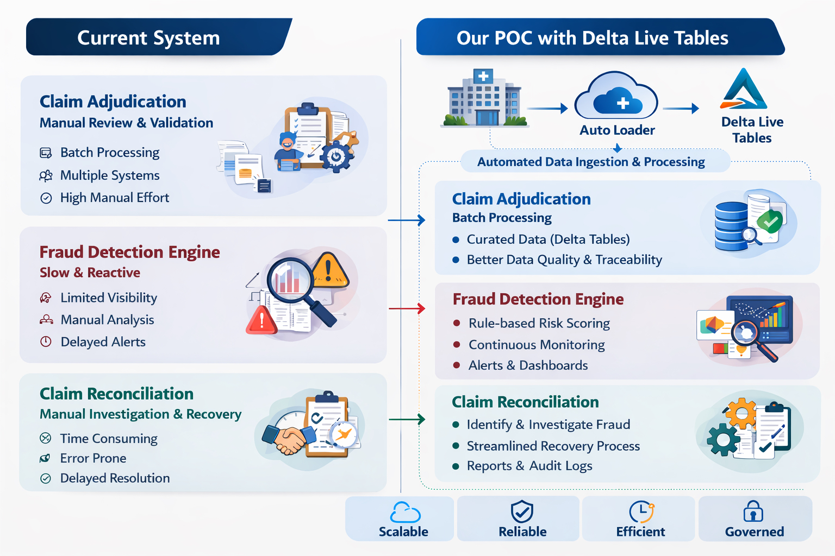
Introduction:
- Yamini

Slide 3
Real-Time Claims Adjudication System
- Yamini

Slide 4



Real-Time Claims Adjudication System
POC Overview:
Build a data pipeline that processes healthcare claims, validates eligibility, calculates payer liability, and determines approval or rejection.
Technology Stack:
Problem Statement
Healthcare insurance systems handle thousands of claims daily. Traditional claim processing often faces several challenges:
• Manual verification of policy eligibility • Delays in claim approvals and payments • Lack of centralized analytics for insurers and hospitals • Difficulty tracking claim settlements and liabilities
These issues result in:
• Slow claim processing • Increased operational costs • Reduced transparency in claim settlements

Slide 5





Business Use Case
The Real-Time Claims Adjudication System processes healthcare claims submitted by hospitals and determines their approval status based on insurance policy rules.
Key Objectives
• Validate patient eligibility • Verify policy coverage limits • Calculate payer liability • Approve or reject claims • Generate payment instructions
Business Value
• Faster claim processing • Reduced manual effort • Improved operational efficiency • Better visibility for insurers and hospitals
Architecture:
DB Volumes
Source files
Source
Bronze
Silver
Gold
Reports

Slide 6
Architecture:
DB Volumes
Source files
Source
Bronze
Silver
Gold
Reports
Batch Ingestion Scheduled Trigger

Slide 7
Data Design (Medallion Architecture)
The pipeline follows Medallion Architecture with three layers:
Bronze Layer
Raw data ingestion from databricks volumes.
Tables: • patients • providers • payers • policies • claims • claim_lines • payments
Silver Layer
Data cleaning and transformation.
SCD implementation for dimensions, flattening nested data
Tables: • silver_patient • silver_provider • silver_payer • silver_policy • silver_claims • silver_claim_lines • silver_payments
Gold Layer
Analytics-ready star schema for reporting.
Dimensions: • dim_patient • dim_provider • dim_policy • dim_payer
Facts: • fact_claims • fact_payments

Slide 8
Analytics & Conclusion
Using the Gold layer, Power BI dashboards provide insights for insurance companies and hospital management.
Key Analytics
• Claim approval ratio • Claims by state • Claims by gender • Claims by specialty • Patient distribution by insurance plan • Claim amount vs payment analysis
Conclusion
The system successfully:
• Implements scalable Medallion Architecture • Enables business analytics through Power BI dashboards • Improves efficiency for insurers and healthcare providers
This solution supports data-driven decision making in healthcare claim processing

